Slide 1



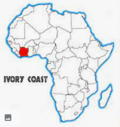

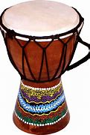
English
In English, we will be writing a non-chronological report on an African elephant and a fictional interview with an animal of our choice.
Science
Our science topic is light and shadow. We will be finding out what a source of light is as well as experimenting with shadows and finding out how they change.
We will also investigate reflection and find out which materials are good reflectors.
Maths
We’ll be starting the term by building on our fraction and geometry skills.
We will then be developing our
addition and subtraction skills using the context of money.
Spring 1 2026
Year 3
Africa
RE
We will be learning about the Hindu celebration of ‘Holi.’ We will be thinking about how Hindus celebrate good and evil through Holi and linking this to Hindu stories.
Geography
In Geography, we will be learning about the Ivory Coast and learning how they impact the chocolate industry.
Computing
In Computing, we will be exploring networks, servers and routers to expand our computing knowledge.
PE
In PE, we will be learning dance and practising our team building skills using Outdoor Adventurous Activities.
Music
In Music we will be working with a music teacher from Hampshire Music Service to learn how to play African percussion instruments.
Art
In Art, we will be creating a print by engraving a polystyrene tile and printing it using ink.
PSHE
We will be learning about rights and respect and how we can keep ourselves, and each other, safe.
.

