Slide 1
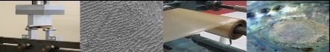



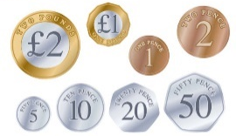
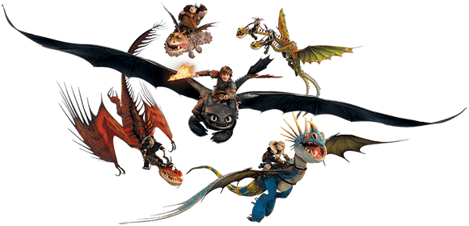


Spanish
The children will be learning the Spanish Alphabet, practising initial sounds phonics and learning vocabulary for different fruits.
Music
The children will be learning how to make their own instruments and create their own music inspired by our topic of Dragons.
Science
The children will be learning about materials. They will explore different properties and think about why they are important. They will learn about different states and relate this to The Water Cycle.
English
In Reading the pupils will be working on exploring new vocabulary and asking and answering questions about information and story texts about dragons.
In Writing the pupils will write non-chronological report to describe different features of their dragon to be presented as a poster. They will also plan and write a story imagining the capture of their dragons by Vikings. The skills focus will be using different sentence types and high quality descriptive language.
Dragons
Year 4
Autumn 1 2025
Maths
The children will be revisiting their understanding of the number system and known facts such as number bonds and times tables. They will then apply these in the context of addition and subtraction in a range of contexts including length and money. They will revisit their mental and written calculation strategies for multiplying and apply them to solve area problems.
ICT
The children will be learning about how a computer works.
Art & Design
The children will be learning about drawing to design and draw their own dragons. They will learn how to mix their own colours and then paint their dragons.
PE
Fundamental Skills: The children will practise a range of skills used in different games.
Dance: The children will explore different cultures and use rhythm and tableaux's to create rhythmic routines as a dragon.
Religious Education
Symbols - The children will be exploring the concept of symbols in Judaism.
PSHE
The children will explore friendships and their feelings.

