Slide 1

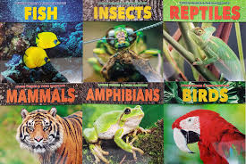


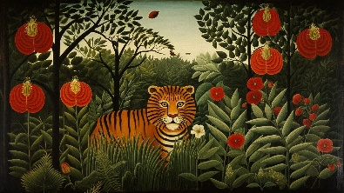
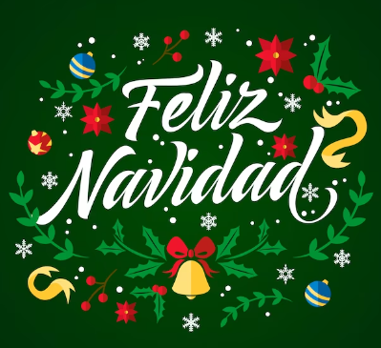
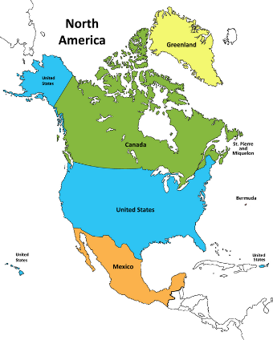

.
English
In English this half term, we will be studying the book Wolf Wilder by Katherine Rundell. From this we will be writing a narrative based on the events in the book and a non-chronological report on wolves.
Science
In science we will be learning about living things and their habitats. We will learn about classification of living things and use dichotomous keys to sort them.
Maths
In Maths, we will be continuing with arithmetic and reasoning each day. We will be revising fractions and percentages and applying this to problem solving.
Identify the value of each digit to three decimal places and multiply and divide numbers by 10,100,1000 where the answers are up to three decimal places.
.
Art
In Art, we will be learning about the artist Henri Roussaeu. We will investigate how his paintings consist of a background, middle ground and foreground. We will use this as inspiration for our own painted scene.
PE
In PE we will be learning how to play netball and each week we will do interval training to help improve our fitness.
Year 6 Autumn 2 2025 – 26
Spanish
We will be learning how to speak about items of clothing in Spanish. We will also learn about Christmas in Spain - Feliz Navidad!
Computing
In computing, we will be learning about website design. We will learn how web pages and sites are created and how to embed media and links.
Geography
In Geography we will be learning about North America. We will find out about how areas of the continent compare to our local area.
.
R.E
In R.E we will be learning about the concept of ‘warning’. We will link this to The Magi in Christianity’s Christmas story.

